Slide 1

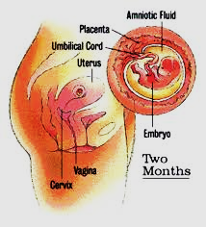
10. Physiology of the pregnancy.
Prof. Sherif W. Mansour
Physiology dpt., Mutah School of medicine
2020-2021

Slide 2
Pregnancy
■ is characterized by steadily increasing levels of estrogen and progesterone, which maintain
the endometrium for the fetus, suppress ovarian follicular function (by inhibiting FSH and LH secretion), and stimulate development of the breasts.
1. Fertilization
■ If fertilization occurs, the corpus luteum is rescued from regression by human chorionic
gonadotropin (HCG), which is produced by the placenta.
2. First trimester
■ The corpus luteum (stimulated by HCG) is responsible for the production of estradiol E2
and progesterone.
■ Peak levels of HCG occur at gestational week 9 and then decline.
3. Second and third trimesters
■ Progesterone is produced by the placenta.
■ Estrogens are produced by the interplay of the fetal adrenal gland and the placenta. The
fetal adrenal gland synthesizes dehydro-epiandrosterone-sulfate (DHEA-S), which is
then hydroxylated in the fetal liver. These intermediates are transferred to the placenta,
where enzymes remove sulfate and aromatize to estrogens. The major placental estrogen
is estriol E3.
■ Human placental lactogen is produced throughout pregnancy. Its actions are similar to
those of growth hormone and prolactin.

Slide 4
FUNCTIONS OF THE PLACENTA
The Feto-placental unit :
The placenta is the site where fetal and maternal circulations are closely associated . Most of the gaseous and metabolic exchanges between fetus and mother take in this region of close proximity , although the place also functions as a barrier to the transfer of large molecules and cells .
A- The placenta is a site of selective exchange :
• Site of transport of nutrient materials for the fetus .
• Site of exchange of respiratory gases .
• It acts as a kidney for the excretion of waste products .
• It prevents the passage of harmful materials to fetus .
B- The placenta as an Endocrine organ for maintaining pregnancy and preparing the mother for labor and lactation : It secretes 5 main hormones :
1- Estrogens :
- Cause enlargement of the breast tissue .
- Cause enlargement of the female external genitalia as a preparation for labor .
- Relax the sacroiliac joint and symphysis pubis ligaments to make easy passage of the fetus through the birth canal .

Slide 5
2- Progesterone :
- Increases decidual reaction development .
- Inhibits uterine contraction and prevents spontaneous abortion .
- Prepares the breast for lactation
3- Chorionic Gonadotrophin :
- It is a glycoprotein having the same function of LH.It replaces the anterior pituitary LH which by the 24th day of the menstrual cycle is only being secreted in small basal quantities because of the steroid feedback inhibition.
- It stimulates the growth of the corpus luteum to be the C.L of pregnancy to increase its secretion of estrogen and progesterone .
- It stimulates the interstitial cells of leyding in the testes of the male fetus to secrete testosterone hormone which causes descend of the testes into the scrotum and stimulates the development of the male sex organs .
- Its detection is the bases of pegnancy tests as it can be detected in maternal blood 6 – 8 days after fertilization .
4- Placental Lactogen (Somato-mammo-trophin)
Recently discovered and secreted about the 5th week of pregnancy .
- It has a luteotrophic function stimulating the corpus luteum to secrete oestrogen and progesterone (previously ascribed to be the function of chorionic gonadorophin) .
- It stimulates breast development (mammotrophic).
- It stimulates cellular growth (growth-promoting effect) and it inhibits glucose transport (inhibits insulin effect) i.e. it is similar to growth hormone .

Slide 6
5- Relaxin hormone (Relaxing Factor) :
It is secreted from the placenta and corpus luteum . It softens and relaxes the pelvice ligaments to help in the process of delivery (there are at least . 3 closely related polypeptides with molecular weight of about 9000 have relaxin activity )
EARLY PREGNANCY TEST
It depends upon detection of chorionic gonadotrophin in urine of pregnant females .
1- Ascheim Zondek Test : Injection of small amount of urine under investigation in immature female mice for 3 days . On the 5th day kill the animal and examine the ovary for the presence of corpus haemorrhagicum and corpus luteurm .
2- Friedman's Test : Injection of small amount of urine under investigation into an isolated virgin female rabbit (isolated from males for at least one month) . The rabbit is killed after 24 to 48 hours to examine the ovaries for the presence of corpus luteum .
3- Toads and Frogs test : Injection of small amount of urine in the dorsal lymph sac of a male frog , within 3 hours the cloaca will be full of sperms .
4- Immunological tests : Very accurate , the presence of human chorionic gonadotropin can be detected when using specific antibodies (prepared in rabbits).

Slide 7
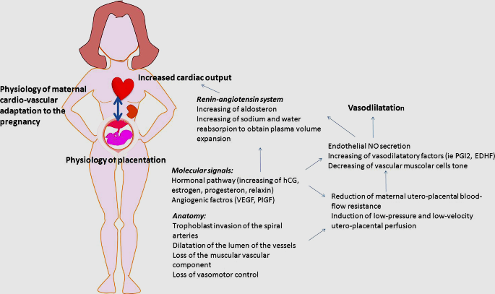

Slide 8
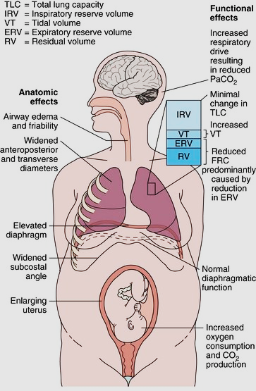

Slide 9
Thank You

